Slide 1
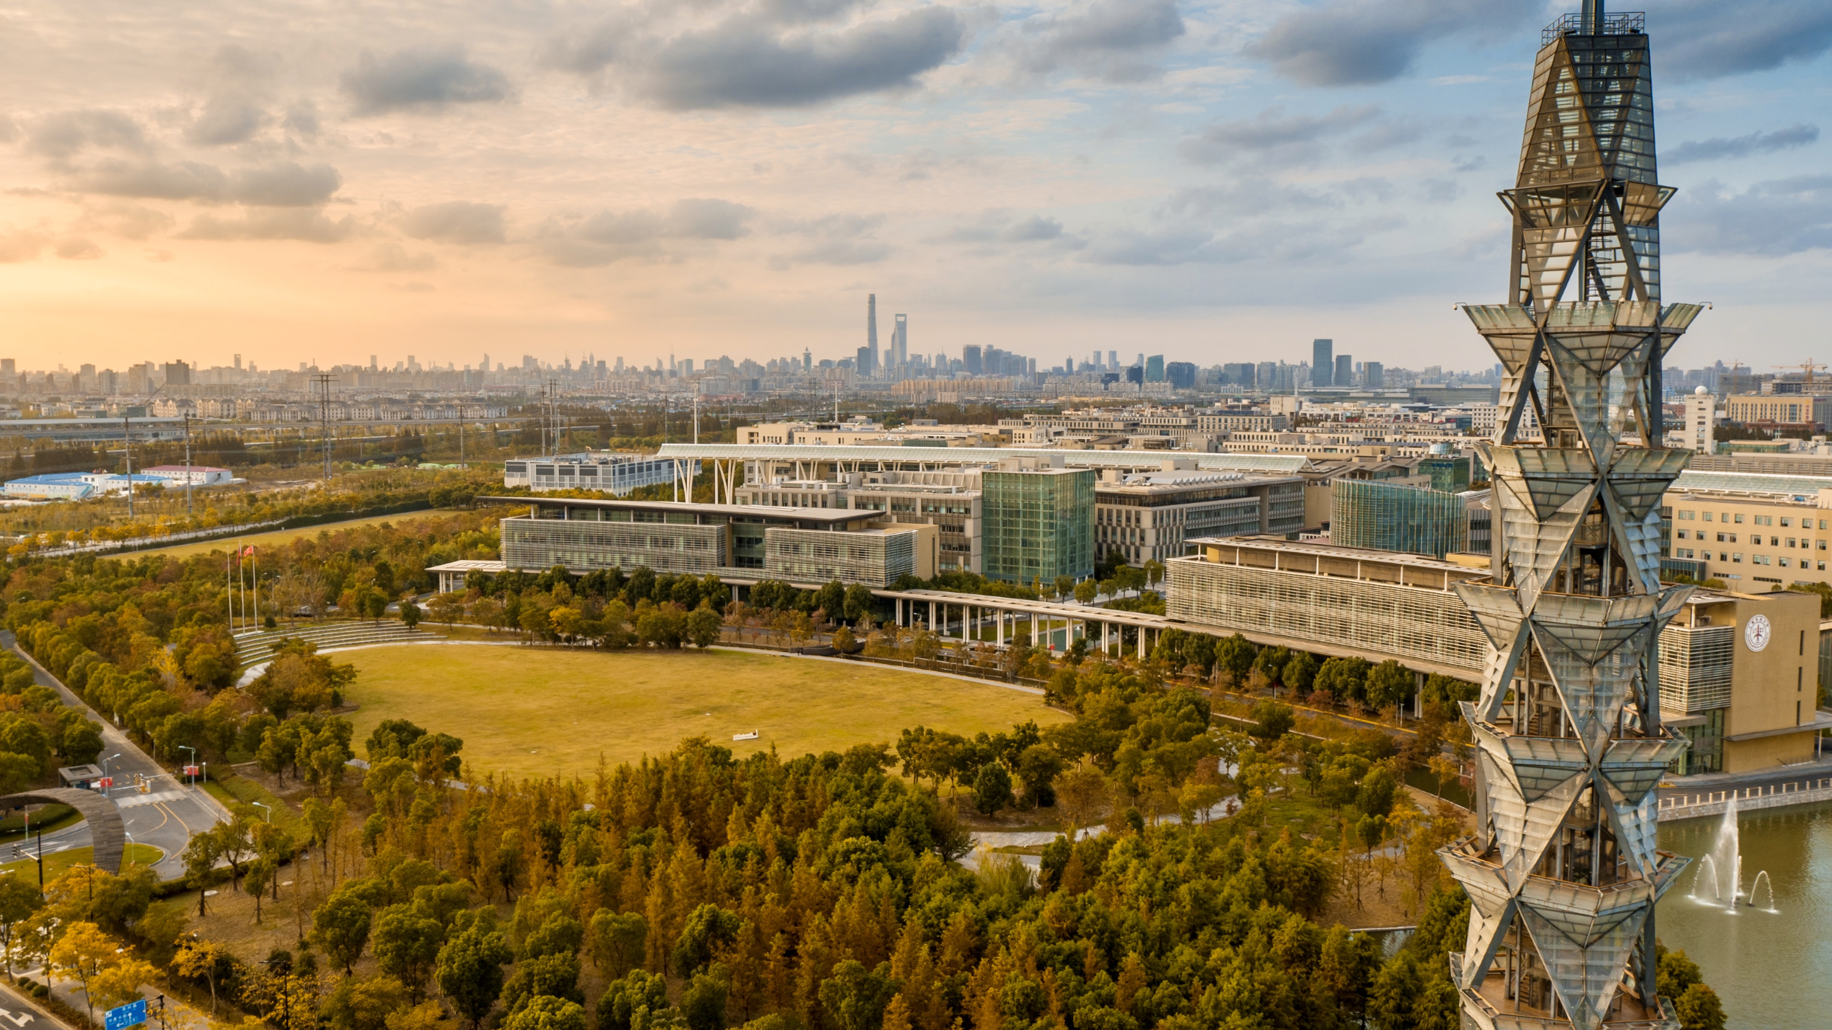


Pattern of Life in ShanghaiTech City
ARTS1422 Final Presentation
王芸飞 贾舜康 夏康杰

Slide 2
Topics
How to use Our System
From Design to Implementation
Insights

Slide 3
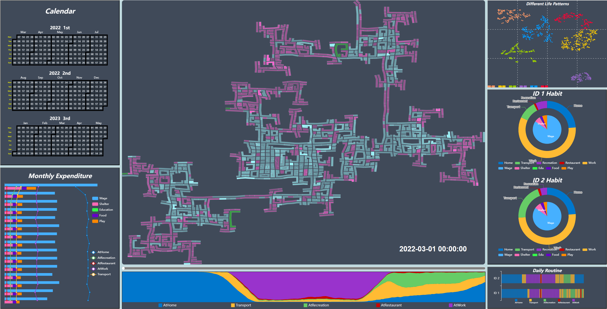
Notes:
Calendar（所有天数）
Total expenditure & time consumption
Map & Timeline （Trajectory on a specific day）
RiverMap（daily time consumption）
Cluster
Pie chart
Daily routine rectangle

Slide 4

At First Glance Overview City Pattern
Map
opacity->busy area in city
Color -> different area
（commercial，residential）

Slide 5
At First Glance Overview City Pattern
Monthly Expenditure & Time consumption

Slide 6
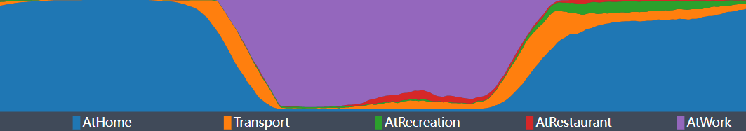
Task 1 – Traffic Pattern
Overview From RiverMap
Drag Timeline For Rush Hour Analysis

Slide 7
Task 2 – Life pattern of a citizen
Click for interested indivduals
Notes:
Overview
Cluster 观察聚类情况
Pie chart展示当前participant一天的平均时间，平均花费规律
Detail
点击某一个特定的participant，会显示当天的行动轨迹
右下角的daily routine表示了当前participant的daily routine(工作日和休息日）

Slide 8
Task 2 – Life pattern of a citizen
Show Overall Time&Money Consumption of individuals
Show Daily Routines

Slide 9
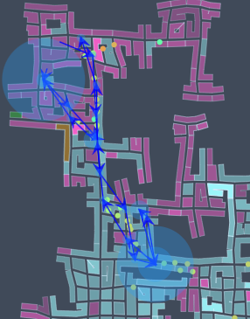
More Details
Trajectory
Choose an Interested Date
Daily Routine

Slide 10
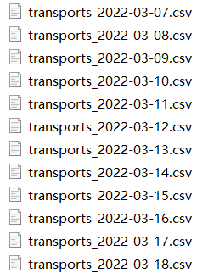

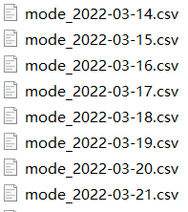
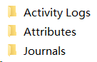
Data Preprocessing
SQLite
z
SQL
Python & SQL
Extract interesting data
Store at backend
Python
Python
Dataset

Slide 11
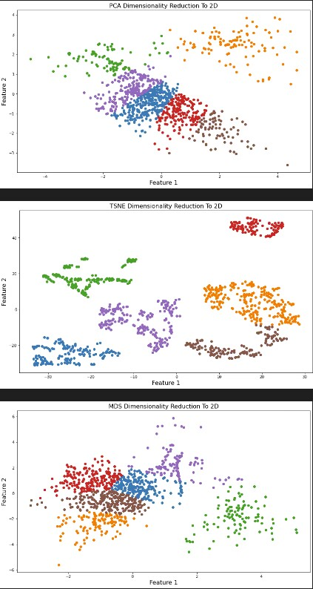
Cluster Method
Based on time consumption ratio and t-SNE performs the best

Slide 12
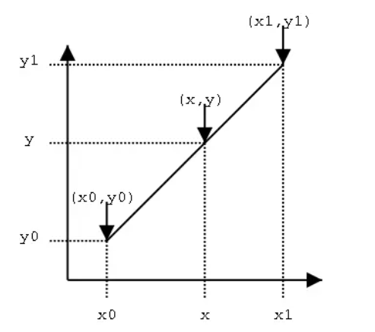
Optimization – Traffic timeline analysis
linear interpolation

Slide 13
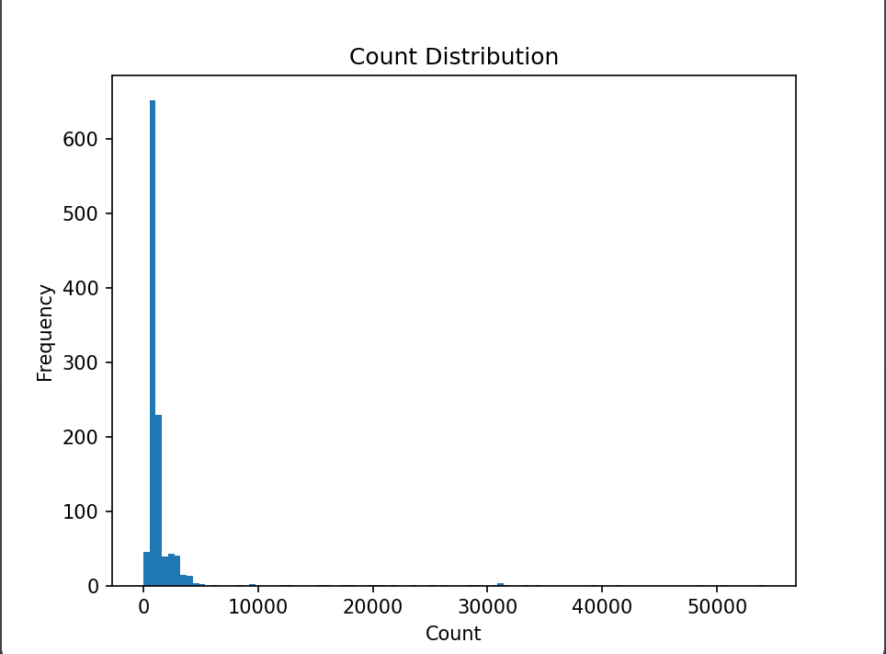
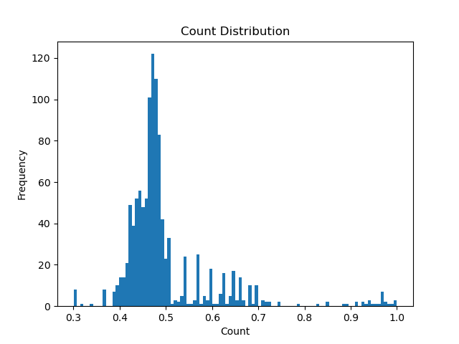
Histogram Equalization
z

Slide 14
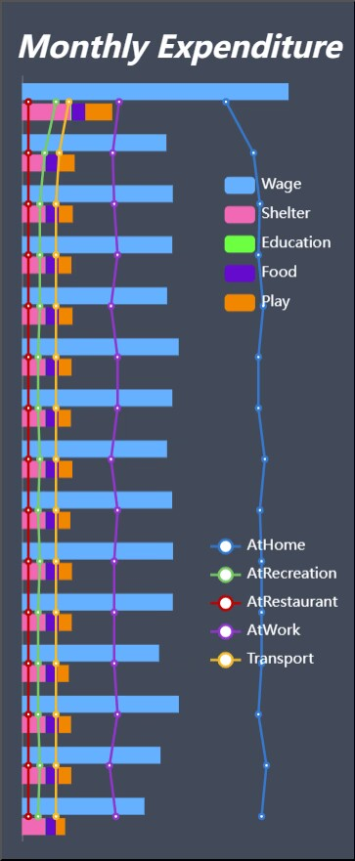
Anomaly First Month Stable City Pattern
City Findings

Slide 15
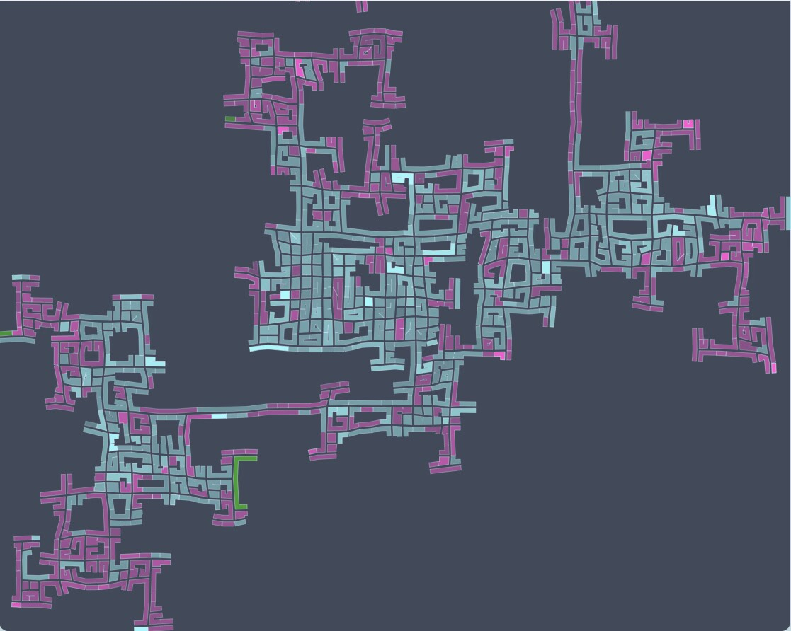
No CBD
City Findings
z

Slide 16
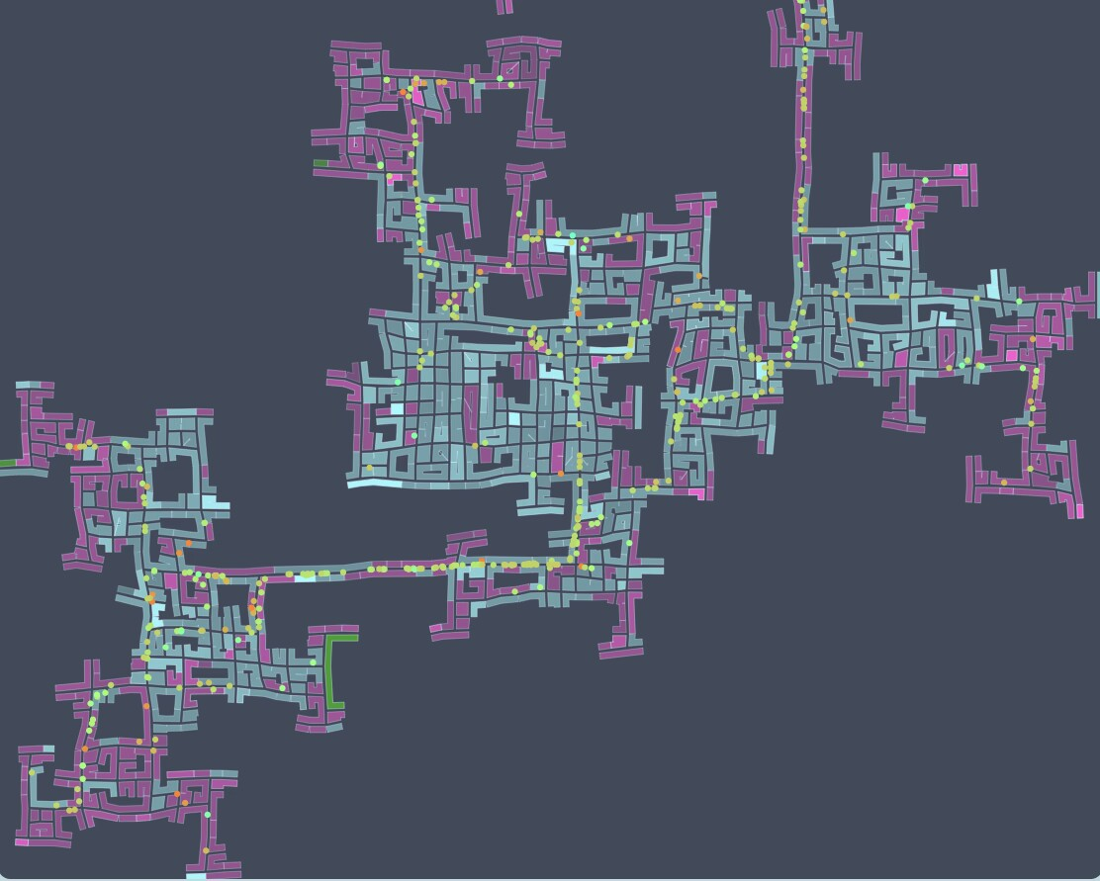
Exist Potential Bottleneck Similar Speed
City Findings
z

Slide 17
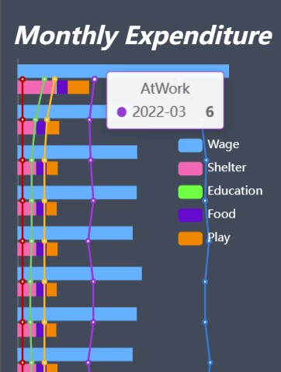
Short Work Hours
Life Pattern Findings
z

Slide 18
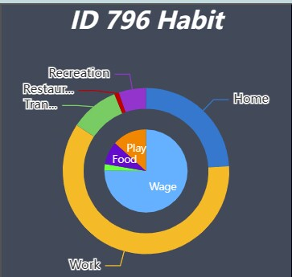
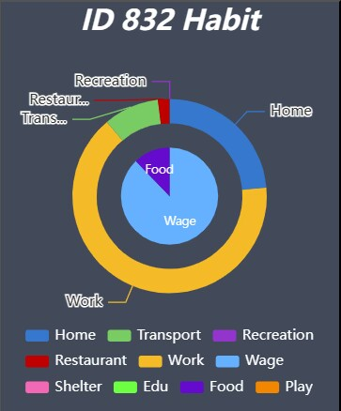
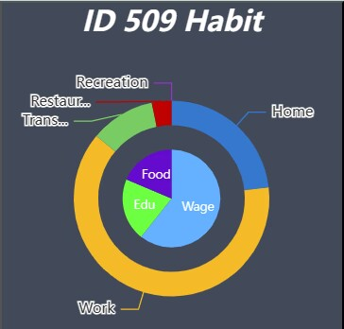
Wierd
Life Pattern Findings
Ordinary
Student

Slide 19
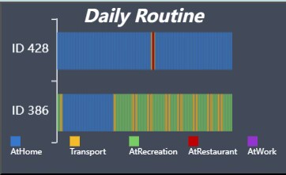
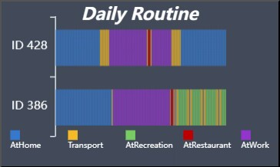
Difference between weekdays & weekends
Life Pattern Findings
2022-03-06
Sunday
2022-03-23
Wednesday

Slide 20
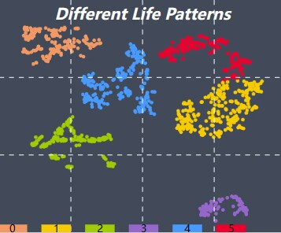
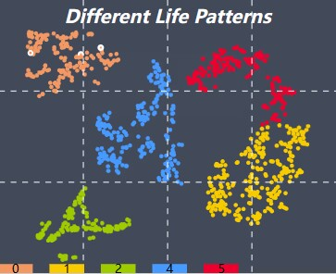
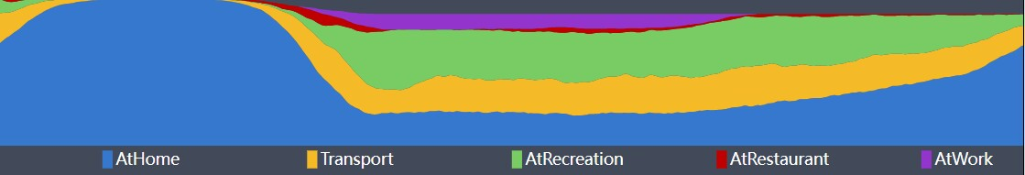
Abnormal Event
2022-03-05
2022-03-06

Slide 21
分工 夏康杰：data preprocessing, map and traffic analysis 王芸飞：calendar, citizen cluster, life pattern analysis 贾舜康：monthly expenditure, design
z

Slide 22
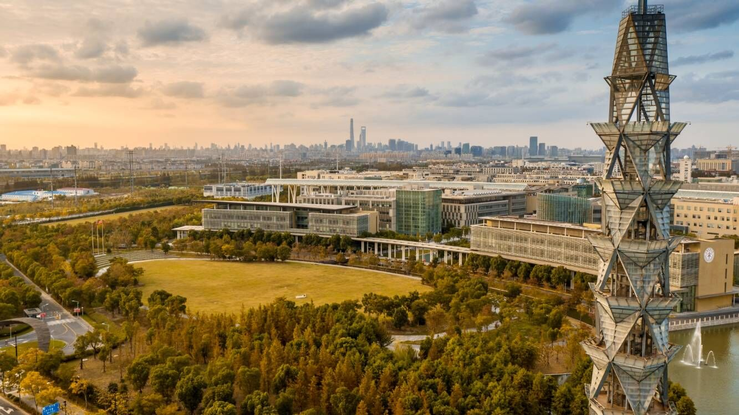
Thanks !
z

